Slide 1

Leonidas
An Assistant for the Elderly
Team 15 Sparta

Slide 2




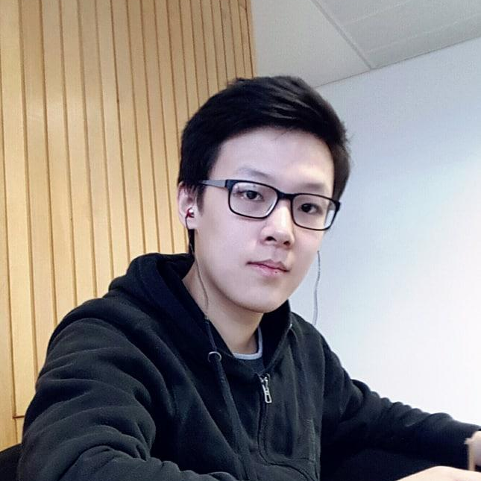

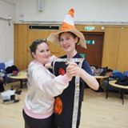
Our Team
Akshay
Agnibho
Vlad
Backend
Researcher
Games
Only has “minor bugs” in his code.
Hates Tesco meal deals.
Hates Microsoft Paint.
Chang
Jason
Stelios
Thomas
Voice commands
Face detection
Games
Penguin
The only one who is understood by Alexa.
Never jokes about anything.
Never pulls an all-nighter
The clumsy one.

Slide 3
Summary
01
Introduction
The motivation behind the project
02
Architecture Overview
The software and hardware architecture
03
Milestones
Leo’s features and functionalities
04
04
Testing and Resource Distribution
Quantitative testing and budget consumption

Slide 4
Introduction

Slide 5
Build an assistive robot
Tackle a problem affecting society

Slide 6
What is the motivation behind the project?

Slide 7
Leonidas
A robot for the elderly!
1 in 14 people in the UK over the age of 65 will develop dementia. A Cambridge study found evidence that suggests playing "brain training" games on an app can reduce the risk of dementia.
https://www.cam.ac.uk/research/news/brain-training-app-found-to-improve-memory-in-people-with-mild-cognitive-impairment
https://www.alzheimers.org.uk/info/20027/news_and_media/541/facts_for_the_media

Slide 8
Why make a robot instead of an app?

Slide 9
Robot engages more senses
A robot interacts with the user physically, while also speaking to it and responding to the users actions. Actions requiring multimodal sensory input have more cognitive benefits.
[1] Hunter EM, Phillips LH, MacPherson SE. Effects of age on cross-modal emotion perception.
https://www.ncbi.nlm.nih.gov/pubmed/21186914
[2] C B. Hall, R B. Lipton, M Sliwinski, M J. Katz, A. Derbyand, J Verghese Cognitive activities delay onset of memory decline in persons who develop dementia.
https://www.ncbi.nlm.nih.gov/pmc/articles/PMC2725932/

Slide 10
Will the elderly respond better to a robot compared to an app?

Slide 11
Surprisingly well!
Age-related deficits in multitasking will be less when more non computer based tasks are used.
People respond better to robots than computer tablets delivering healthcare instructions.
[1] Jordan A.Mann, Bruce A.MacDonald, I.-Han Kuo, Xingyan Li, Elizabeth Broadbent People respond better to robots than computer tablets delivering healthcare instructions. https://www.sciencedirect.com/science/article/pii/S0747563214005524
[2] Marla Kosowicz, Sarah E.MacPherson Improving multitasking assessment in healthy older adults using a prop-based version of the Breakfast task. https://www.tandfonline.com/doi/full/10.1080/23279095.2015.1136310

Slide 12
Robot plays beneficial games
Reaction testing games - Arcade style games that require pressing buttons engage motor cognition.
Memory games - Improve ability to retain information

Slide 13
Architecture Overview

Slide 14
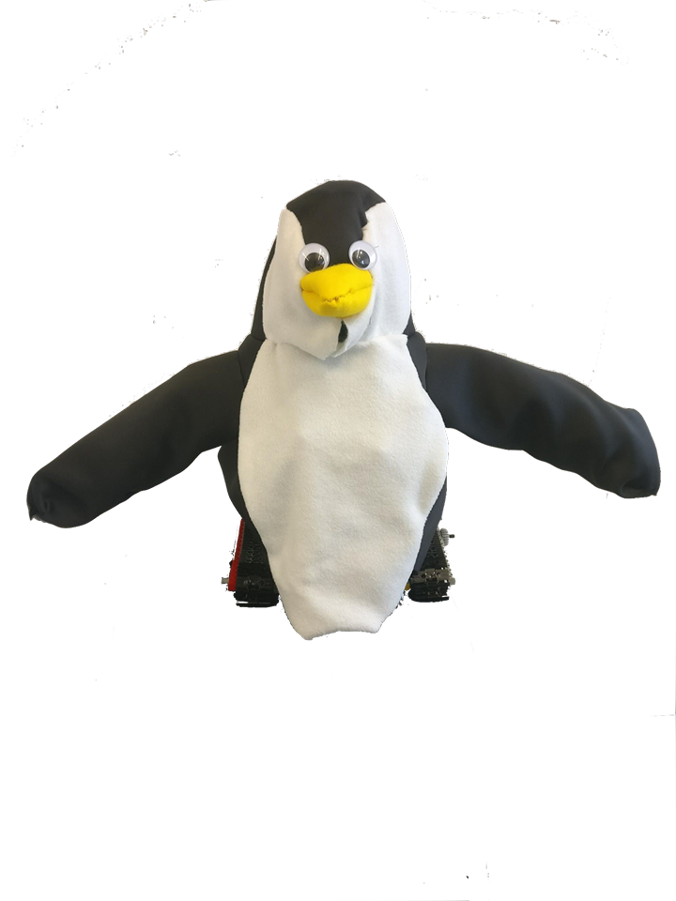
Leo is a Penguin
ARMS
Move in a single plane
Each arm has an elbow joint to move hand/elbow
LEDs
Three colours Red, Green and Yellow
Controlled by RPI via GPIO pins
Tracks
Chosen over wheel system as it’s easier to program movement over a table, can go over minor bumps and over minor table gaps

Slide 15
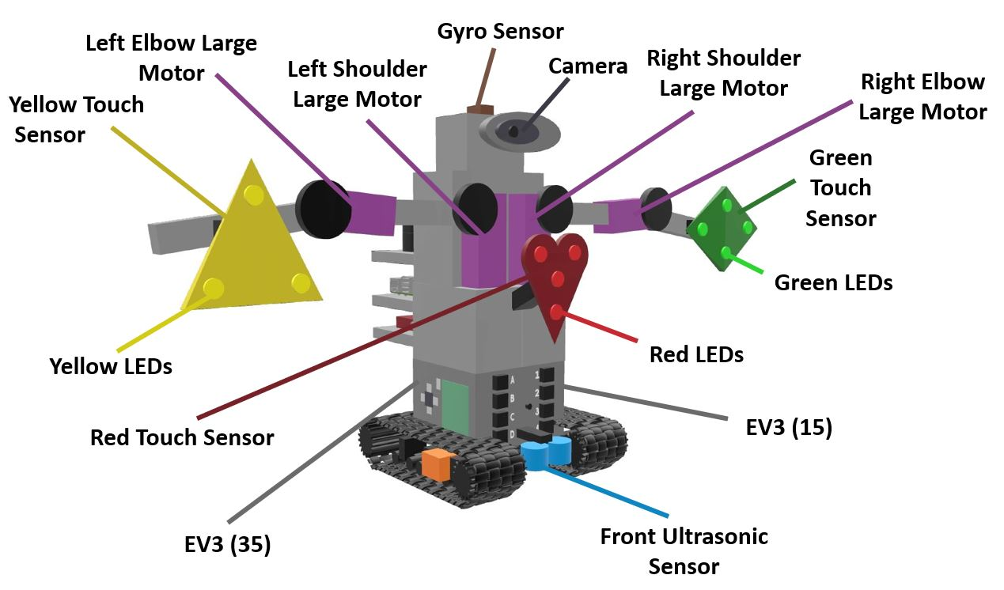
Hardware Overview (Front)

Slide 16
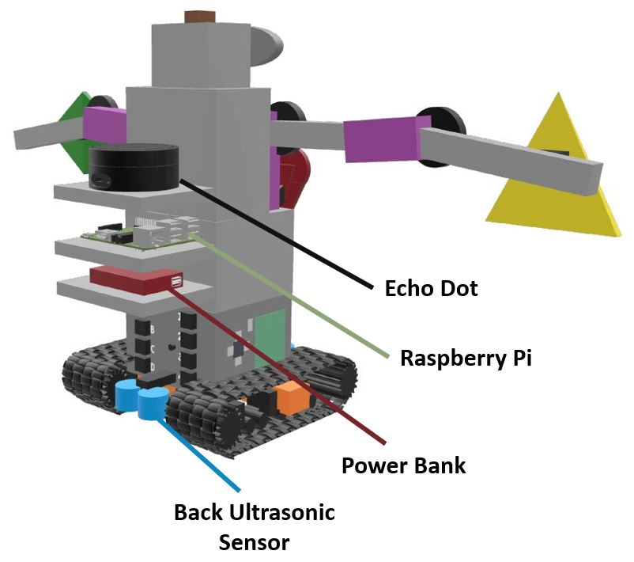
Hardware Overview (Back)

Slide 17
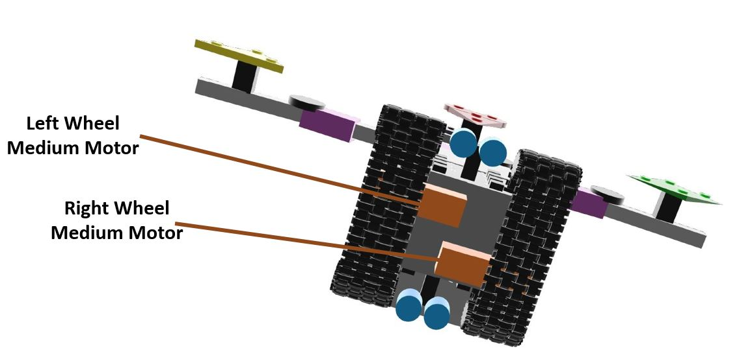
Hardware Overview (Bottom)

Slide 18
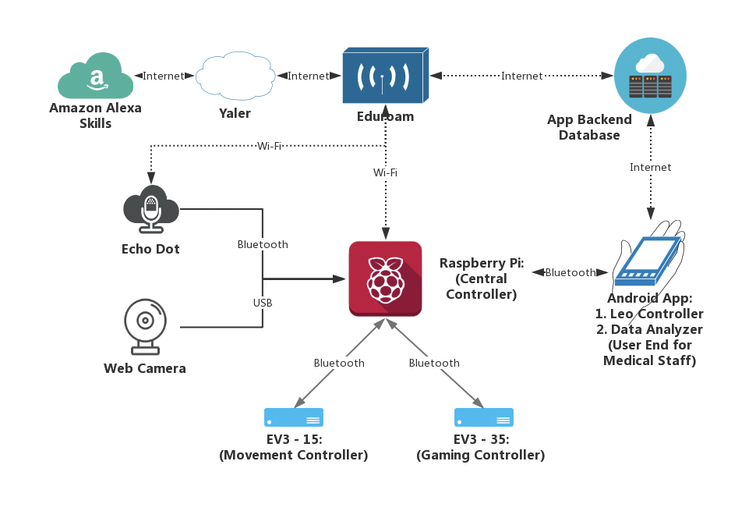
Software Overview

Slide 19
Milestones

Slide 20
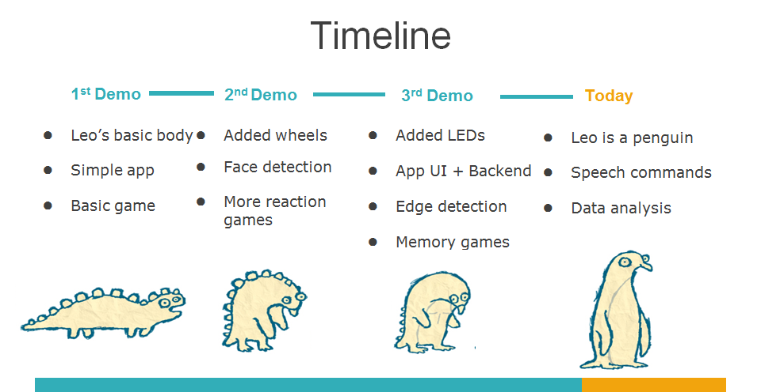
Timeline
1st Demo
2nd Demo
3rd Demo
Today
Robot prototype
Draft phone App
First game
Add wheels to the robot
Add camera to the robot
Make the robot speak and play some music
Make a double arm reaction game, sending stats to the app
Add a Raspberry Pi on the robot
Add edge detection, avoid robot falling off the table
Add login screen and graph representDation of reactions to the App
Finalise the communication with Raspberry Pi and other devices
Add LEDs to the robot
Add a memory game to the robot using the LEDs
Improve face detection
Finalise App
Add Echo Dot to the robot
Implement Amazon Alexa for giving voice commands
Finalise Face Detection
Add 6 memory games, and 5 reaction games to the robot
Make robot look more user friendly (penguin costume)

Slide 21
Game Features
01
Reaction Game
02
Memory Game
03
Data Collection

Slide 22
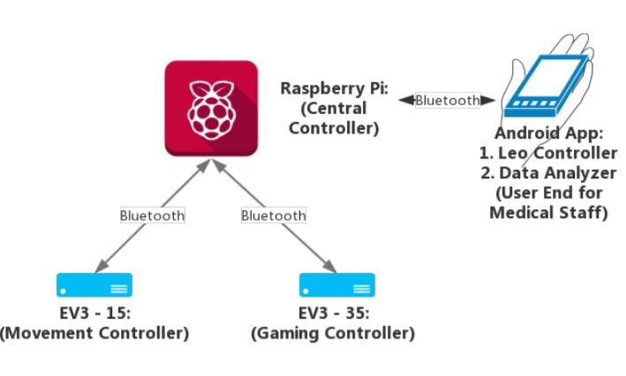
EV3 ↔ APP Communication
Bluetooth Based
Using MQTT publish /subscribe messaging protocol
Ignores messages sent if the current game is still running
Notes:
Different message topic sent to each device, depending on current game
The broker is Raspberry Pi, the heart of the protocol

Slide 23
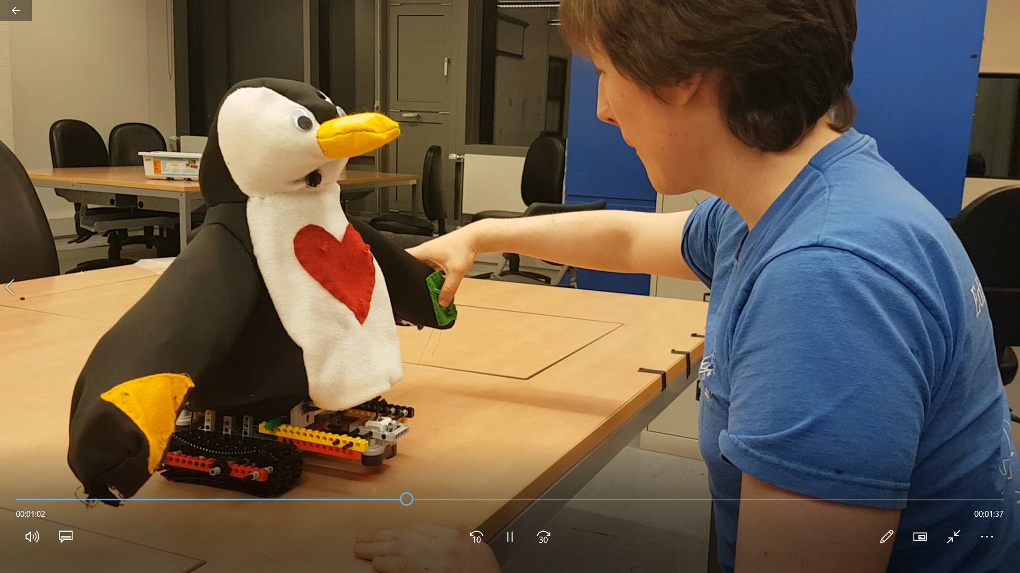
Play with Leo
Reaction games
Select a reaction game from the app
Follow the robot movements
When the robot stops moving, hit its arm buttons
Continue until game is Robot stops moving entirely
Notes:
Different message topic sent to each device, depending on current game
The broker is Raspberry Pi, the heart of the protocol

Slide 24
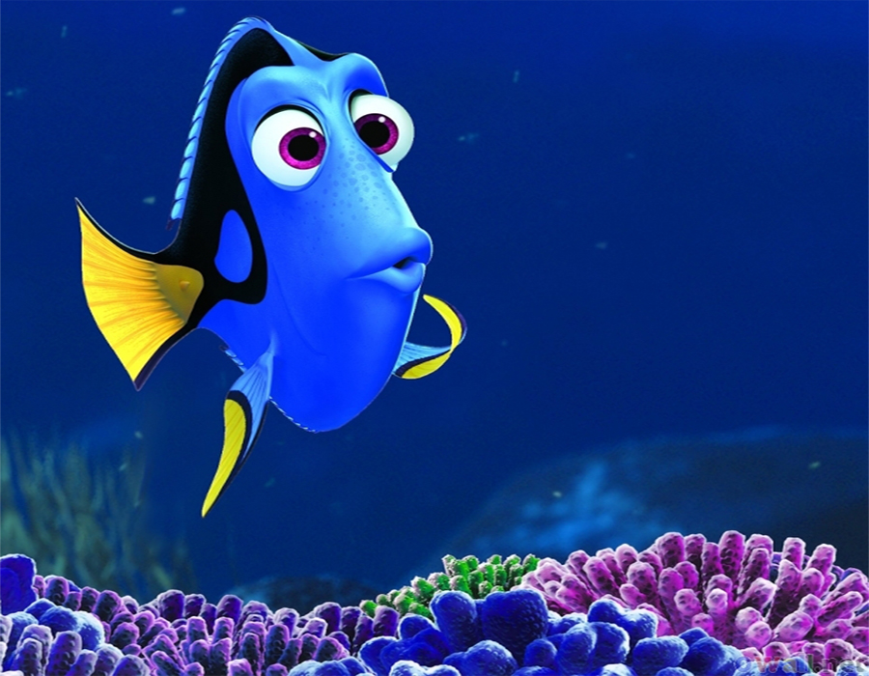
Play with Leo
Memory games
Select a memory game from the app.
Memorize the LED pattern displayed by Leo
Wait for Leo to say “Ready”
Repeat the LED pattern
Notes:
Different message topic sent to each device, depending on current game
The broker is Raspberry Pi, the heart of the protocol

Slide 25
HRI Features
01
Android App
04
Face Detection
02
Backend
05
Edge Detection
03
Voice Command
06
Companionship

Slide 26
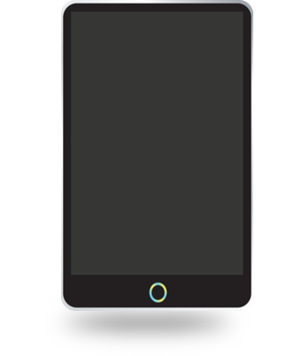


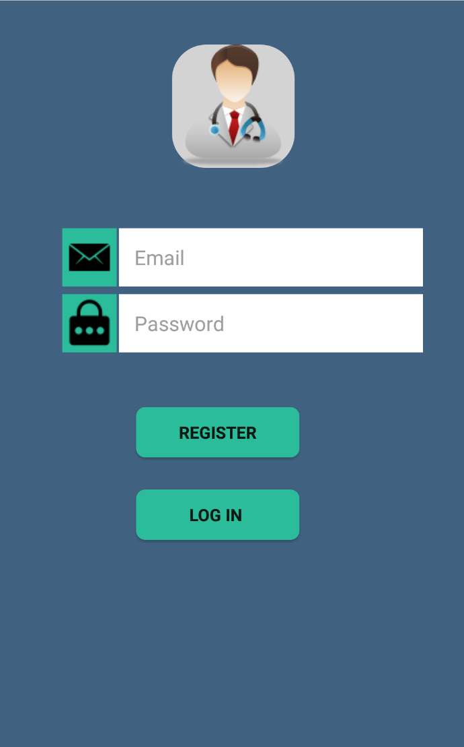




Android App
Features and Functionality
User Authentication
User email
Gaming
Data Analysis
Data visualisation
Settings
Face Detection
Backend Server
Notes:
Register different users and login with your details
Play basic interaction, pattern memory and time reaction games with the robot
The robot will detect your face and will move closer or away from you.
Visualise your performance in the form of graphs and numbers
Send your performance data to your email. Select your email provider yourself.
Analyses your performance data against all user data and suggests an easier/harder game
View your account details and your average score. Set email to send your data to.
Stores all user authentication, performance and session data

Slide 27
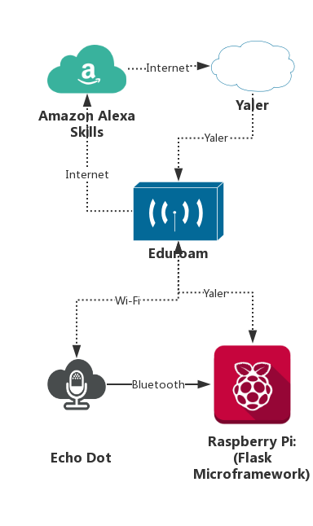
Alexa Skills
Voice Command
powered by Amazon Alexa
Alexa Intents
Automatically Setup
‘Ask Leo to set up’
Connect to App
‘Ask Leo to connect’
Detect the User’s Face
‘Ask Leo to find me’
Play A Game
‘Ask Leo to play a easy memory game’
Yaler
Flask

Slide 28
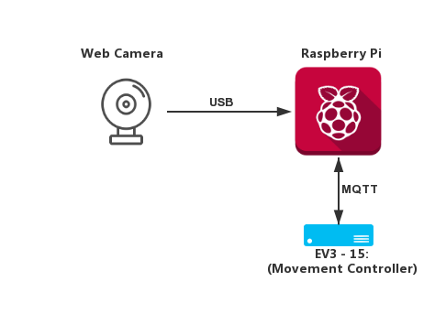
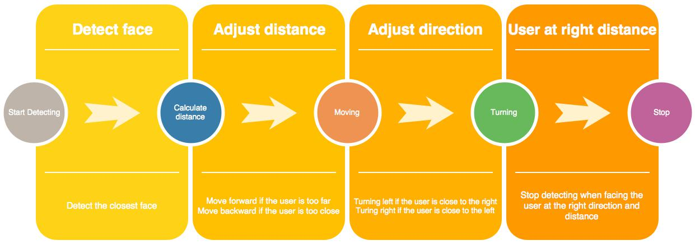

Uses the OpenCV Library
XML training file licensed by Intel
Keeps Leo at an appropriate distance from the user
Edge Detection
Face Detection Leo is looking for you

Slide 29
Demo Time

Slide 30
Testing

Slide 31
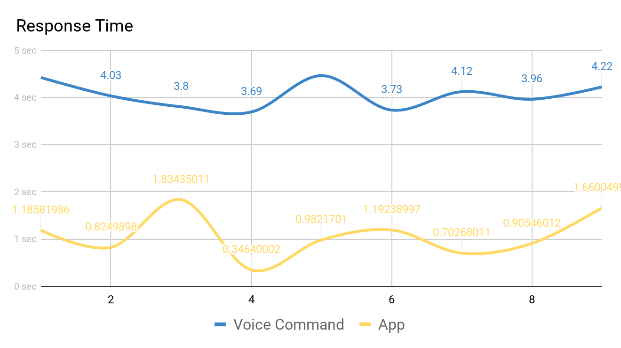
Response Time
Quantitative Testing
Of
Response Time
 | Voice Command | App Control
Average Time | 4.04778 sec | 1.07047 sec

Slide 32
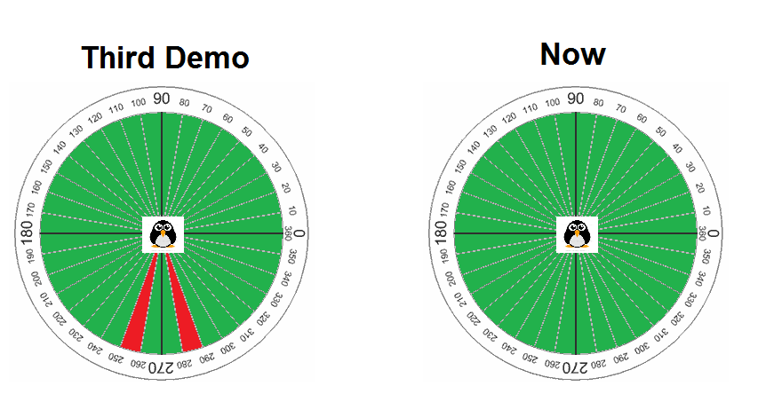
Edge detection
Quantitative Testing
Of
Edge detection
 | Third Demo | Now
Success rate for danger zone | 55% (out of 20 tries) | 100% (out of 20 tries)

Slide 33
Budget

Slide 34
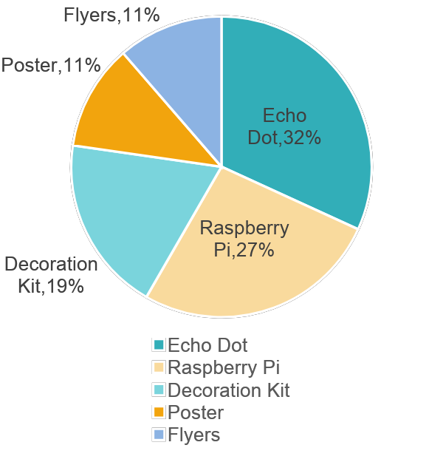
Budget Consumption
Item | Count | Cost | Balance
Webcam | 1 | Free | 200
Raspberry Pi | 1 | 35 | 165
16G SD Card | 1 | Free
Echo Dot | 1 | 42 | 123
LEDs | 11 | Free
Decoration Kit | 1 | 25 | 98
Poster | 1 | 20 | 78
Flyers | 25 | 18 | 60
Total |  | 10 | 60

Slide 35
Thank you

